Slide 1
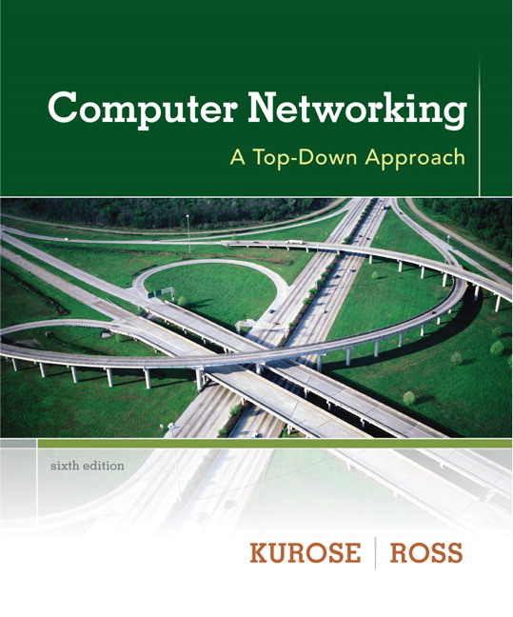
Chapter 5 Link Layer
Computer Networking: A Top Down Approach 6th edition Jim Kurose, Keith Ross Addison-Wesley March 2012
Course Name:
Computer Networks
Lecture by:
Dr. Moeenuddin Tariq

Slide 2

Link layer, LANs: outline
5.1 introduction, services
5.2 error detection, correction
5.3 multiple access protocols
5.4 LANs
addressing, ARP
Ethernet
switches
VLANS
5.5 link virtualization: MPLS
5.6 data center networking
5.7 a day in the life of a web request

Slide 3


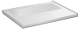


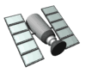
Multiple access links, protocols
two types of “links”:
point-to-point
PPP for dial-up access
point-to-point link between Ethernet switch, host
broadcast (shared wire or medium)
old-fashioned Ethernet
upstream HFC
802.11 wireless LAN
shared wire (e.g.,
cabled Ethernet)
shared RF
(e.g., 802.11 WiFi)
shared RF
(satellite)
humans at a
cocktail party
(shared air, acoustical)

Slide 4
Multiple access protocols
single shared broadcast channel
two or more simultaneous transmissions by nodes: interference
collision if node receives two or more signals at the same time
multiple access protocol
distributed algorithm that determines how nodes share channel, i.e., determine when node can transmit
communication about channel sharing must use channel itself!
no out-of-band channel for coordination

Slide 5
An ideal multiple access protocol
given: broadcast channel of rate R bps
desiderata:
1. when one node wants to transmit, it can send at rate R.
2. when M nodes want to transmit, each can send at average rate R/M
3. fully decentralized:
no special node to coordinate transmissions
no synchronization of clocks, slots
4. simple

Slide 6
MAC protocols: taxonomy
three broad classes:
channel partitioning
divide channel into smaller “pieces” (time slots, frequency, code)
allocate piece to node for exclusive use
random access
channel not divided, allow collisions
“recover” from collisions
“taking turns”
nodes take turns, but nodes with more to send can take longer turns

Slide 7
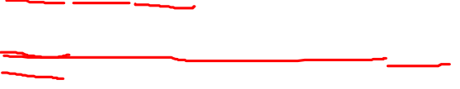
Channel partitioning MAC protocols: TDMA
TDMA: time division multiple access
access to channel in "rounds"
each station gets fixed length slot (length = pkt trans time) in each round
unused slots go idle
example: 6-station LAN, 1,3,4 have pkt, slots 2,5,6 idle
6-slot
frame
6-slot
frame
1
3
4
1
3
4

Slide 8
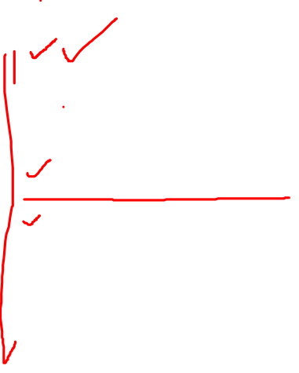
Channel partitioning MAC protocols: FDMA
FDMA: frequency division multiple access
channel spectrum divided into frequency bands
each station assigned fixed frequency band
unused transmission time in frequency bands go idle
example: 6-station LAN, 1,3,4 have pkt, frequency bands 2,5,6 idle
time
frequency bands
FDM cable

Slide 9

Random access protocols
when node has packet to send
transmit at full channel data rate R.
no a priori coordination among nodes
two or more transmitting nodes ➜ “collision”,
random access MAC protocol specifies:
how to detect collisions
how to recover from collisions (e.g., via delayed retransmissions)
examples of random access MAC protocols:
slotted ALOHA
ALOHA
CSMA, CSMA/CD, CSMA/CA

Slide 10
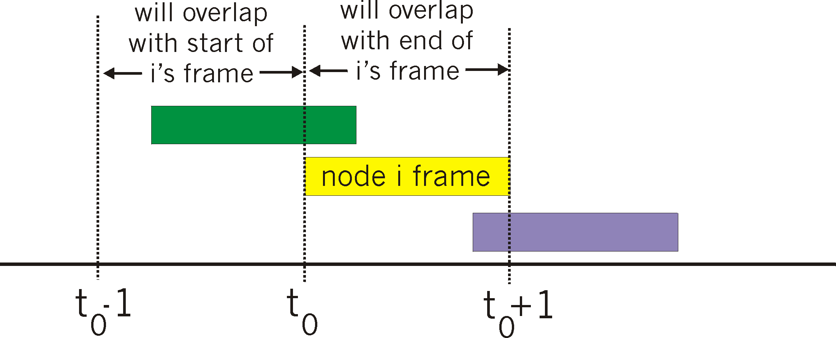
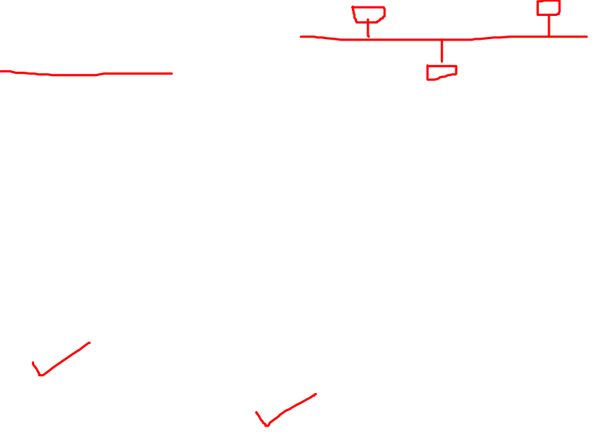
Pure (unslotted) ALOHA
unslotted Aloha: simpler, no synchronization
when frame first arrives
transmit immediately
collision probability increases:
frame sent at t₀ collides with other frames sent in [t₀-1,t₀+1]

Slide 11
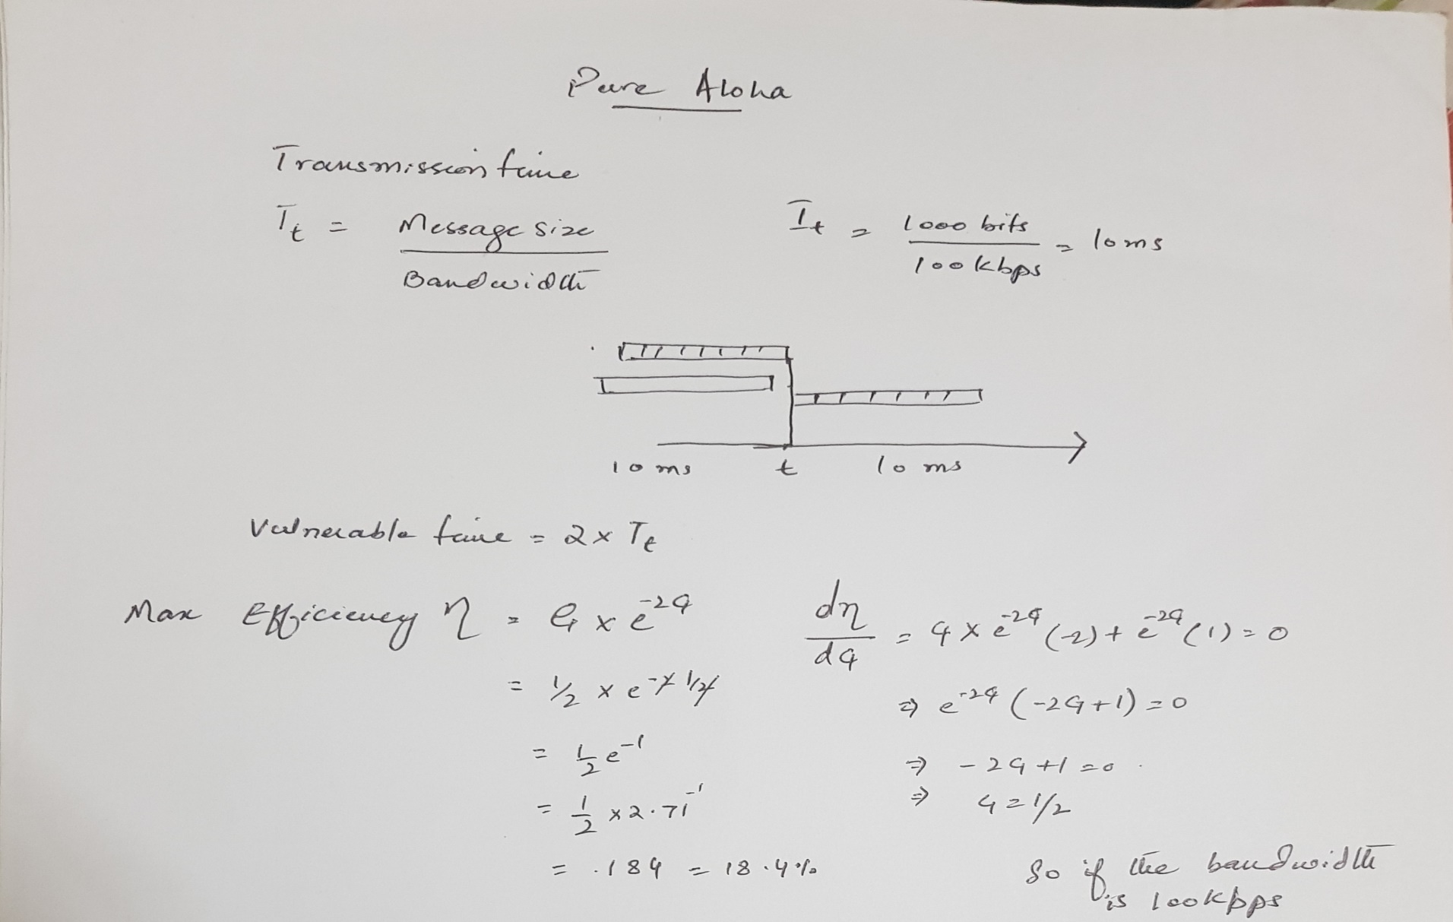

Pure ALOHA efficiency

Slide 12
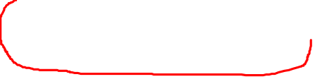
Slotted ALOHA
assumptions:
all frames same size
time divided into equal size slots (time to transmit 1 frame)
nodes start to transmit only slot beginning
nodes are synchronized
if 2 or more nodes transmit in slot, all nodes detect collision
operation:
when node obtains fresh frame, transmits in next slot
if no collision: node can send new frame in next slot
if collision: node retransmits frame in each subsequent slot with prob. p until success

Slide 13

Slotted ALOHA
node 1
1
1
1
1
node 2
2
2
2
node 3
3
3
3
C
E
C
S
E
C
E
S
S
Pros:
single active node can continuously transmit at full rate of channel
highly decentralized: only slots in nodes need to be in sync
simple
Cons:
collisions, wasting slots
idle slots
nodes may be able to detect collision in less than time to transmit packet
clock synchronization

Slide 14
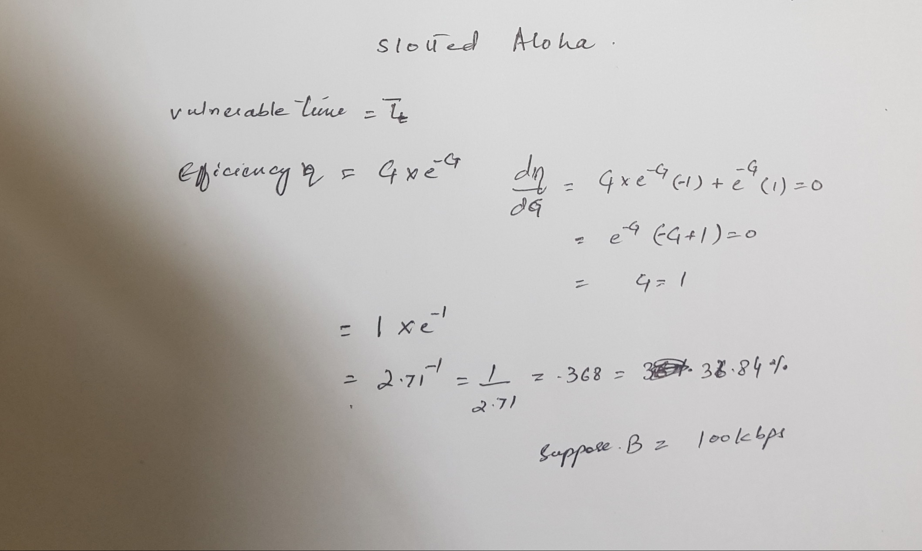
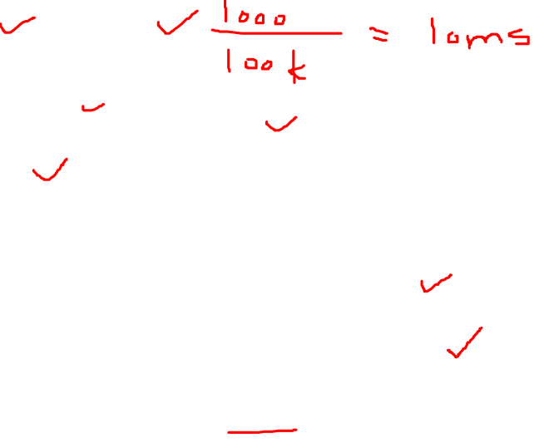
Slotted ALOHA: efficiency

Slide 15
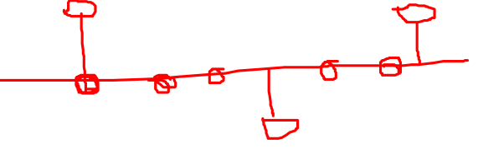
CSMA (carrier sense multiple access)
CSMA: listen before transmit:
if channel sensed idle: transmit entire frame
if channel sensed busy, defer transmission
human analogy: don’t interrupt others!

Slide 16
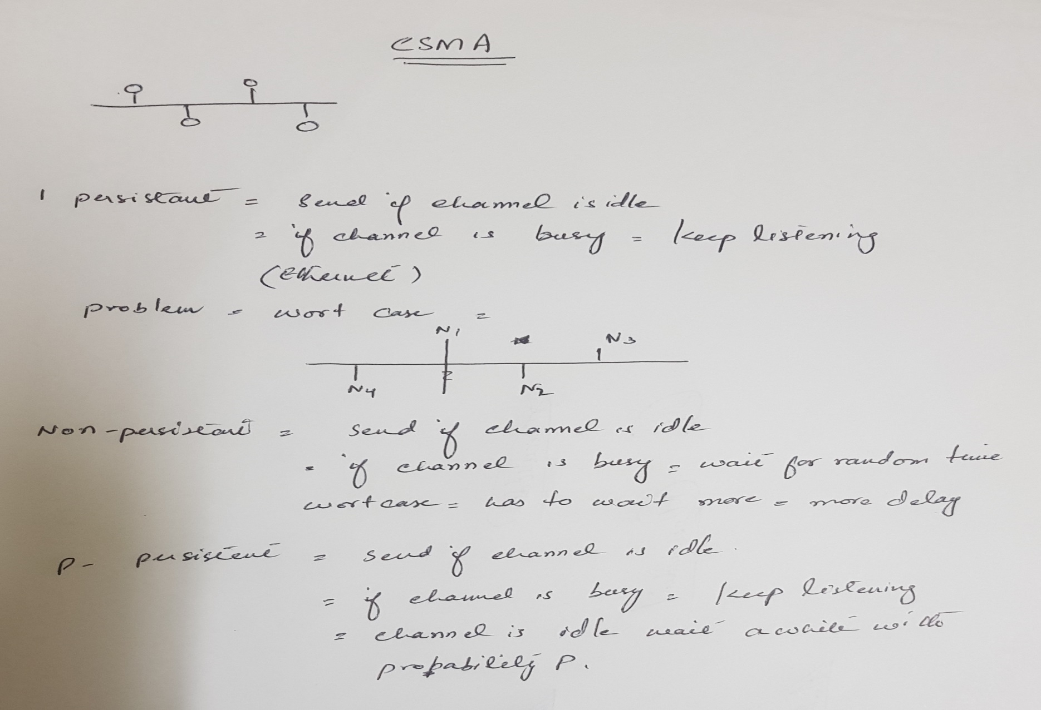
CSMA (carrier sense multiple access)

Slide 17
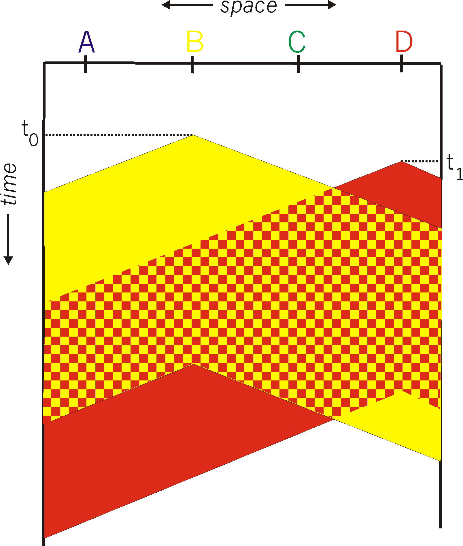
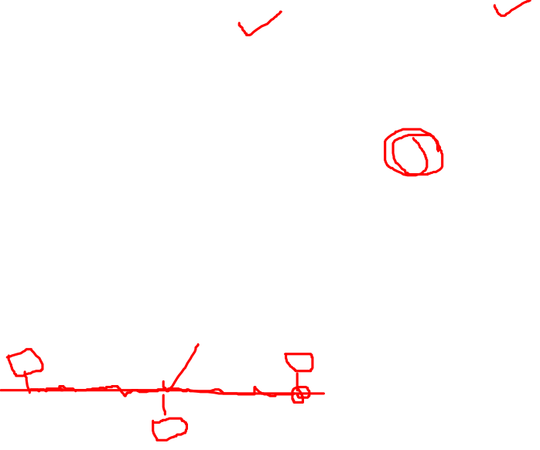
CSMA collisions
spatial layout of nodes
collisions can still occur: propagation delay means two nodes may not hear each other’s transmission
collision: entire packet transmission time wasted
distance & propagation delay play role in in determining collision probability

Slide 18
CSMA/CD (collision detection)
CSMA/CD: carrier sensing, deferral as in CSMA
collisions detected within short time
colliding transmissions aborted, reducing channel wastage
collision detection:
easy in wired LANs: measure signal strengths, compare transmitted, received signals
difficult in wireless LANs: received signal strength overwhelmed by local transmission strength
human analogy: the polite conversationalist

Slide 19
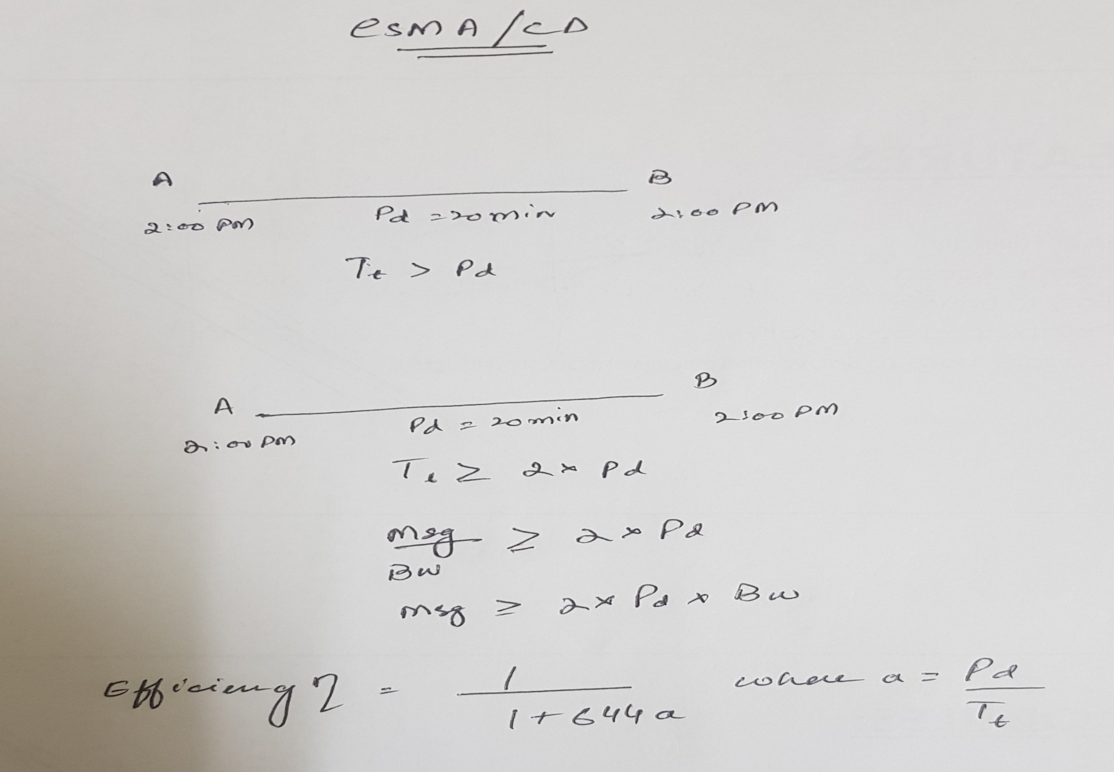

CSMA/CD (collision detection)

Slide 20
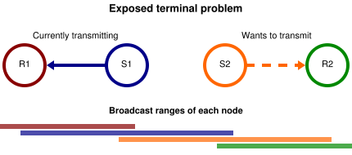
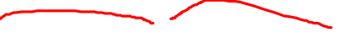
Hidden and exposed terminals
Hidden terminals
A sends to B, C cannot receive A
C wants to send to B, C senses a “free” medium (CS fails)
collision at B, A cannot receive the collision (CD fails)
A is “hidden” for C
Exposed terminals
B sends to A, C wants to send to another terminal (not A/B)
C has to wait, CS signals a medium in use
but A is outside the radio range of C, therefore waiting is not necessary
C is “exposed” to B
A
B
C

Slide 21
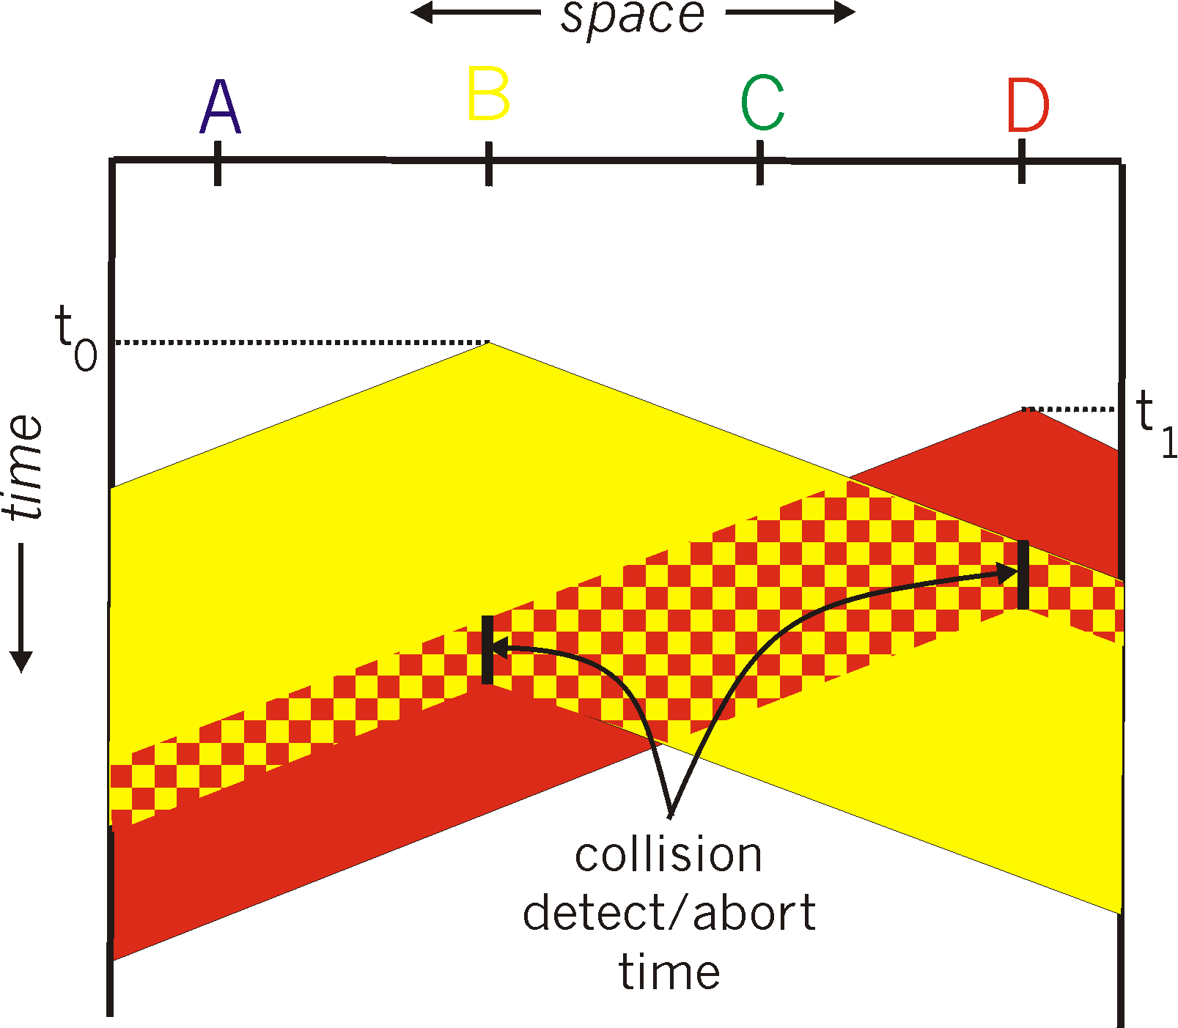
CSMA/CD (collision detection)
spatial layout of nodes

Slide 22
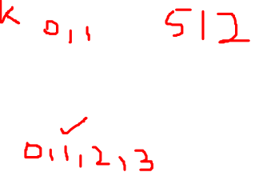
Ethernet CSMA/CD algorithm
1. NIC receives datagram from network layer, creates frame
2. If NIC senses channel idle, starts frame transmission. If NIC senses channel busy, waits until channel idle, then transmits.
3. If NIC transmits entire frame without detecting another transmission, NIC is done with frame !
4. If NIC detects another transmission while transmitting, aborts and sends jam signal
5. After aborting, NIC enters binary (exponential) backoff:
after mth collision, NIC chooses K at random from {0,1,2, …, 2^{m}-1}. NIC waits K·512 bit times, returns to Step 2
longer backoff interval with more collisions

Slide 23
CSMA/CD efficiency
T_{prop} = max prop delay between 2 nodes in LAN
t_{trans} = time to transmit max-size frame
efficiency goes to 1
as t_{prop} goes to 0
as t_{trans} goes to infinity
better performance than ALOHA: and simple, cheap, decentralized!

Slide 24
“Taking turns” MAC protocols
channel partitioning MAC protocols:
share channel efficiently and fairly at high load
inefficient at low load: delay in channel access, 1/N bandwidth allocated even if only 1 active node!
random access MAC protocols
efficient at low load: single node can fully utilize channel
high load: collision overhead
“taking turns” protocols
look for best of both worlds!

Slide 25

“Taking turns” MAC protocols
polling:
master node “invites” slave nodes to transmit in turn
typically used with “dumb” slave devices
concerns:
polling overhead
latency
single point of failure (master)
data
poll
master
data
slaves

Slide 26
“Taking turns” MAC protocols
token passing:
control token passed from one node to next sequentially.
token message
concerns:
token overhead
latency
single point of failure (token)
T
(nothing
to send)
T
data

